Slide 1
Network Flow Classification
Detecting Patterns in Network Traffic
27-01-2025 By hit kalariya

Slide 2

Agenda
Introduction
Problem Statement
Dataset Overview
Feature Selection
Machine Learning Models
Training Process
Results
Challenges & Solutions
Future Scope
Conclusion

Slide 3

Introduction
Problem Statement: Efficient classification of network traffic data to enhance detection and decision-making processes.
Purpose:
Improve network security
Optimize traffic performance
Relevance: Identifying malicious activities and unusual patterns is critical for maintaining secure systems.

Slide 4
Problem Statement
Challenge:
Rapid increase in network traffic and cyber threats.
Impact:
Mismanagement can lead to security breaches and performance degradation.
Need:
Accurate classification for better detection and mitigation.

Slide 5
Dataset Overview
Size: [79 columns with 225,745 entries] records.
Features: 5 significant attributes:
- Bwd Packet Length Max
- Fwd Packet Length Max
- Init_Win_bytes_forward
- act_data_pkt_fwd
- Subflow Fwd Bytes
Preprocessing Steps:
- Handled missing values.
- Standardized feature scaling.

Slide 6
Feature Selection
Techniques:
- Analyzed feature importance.
- Removed redundant features using correlation analysis.
Significant Features:
- Fwd Packet Length Max
- Init_Win_bytes_forward
- Their high correlation with output improved accuracy.

Slide 7
Machine Learning Models
Models Used:
- EXTRA TREES
- Random Forest
- Decision Tree
- XGBOOST
Frameworks:
- Scikit-learn for implementation.
- Pandas and Matplotlib for data analysis and visualization.
Best Performing Model:
- Random Forest with optimal parameters.

Slide 8
Training Process
Steps Taken:
1. Splitting data into training and testing sets.
2. Hyperparameter tuning for optimization.
3. Evaluating models using metrics like accuracy andF1-score.
Tools Used:
Jupyter Notebook and Python libraries.

Slide 9
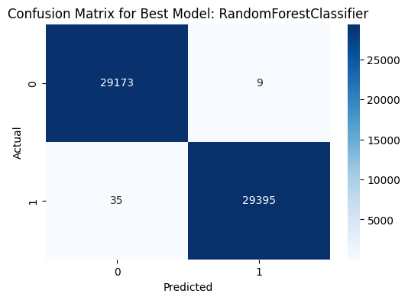
Results
Best Model Performance:
Precision: 0.9997619533428552
Recall: 0.9989466530750934
F1 Score: 0.9993541369229724
Visuals:
- Confusion Matrix
- ROC Curve

Slide 10
Challenges & Solutions
Challenge 1: Imbalanced Dataset
Solution: Applied SMOTE for balancing.
Challenge 2: Feature Redundancy
Solution: Conducted correlation analysis to reduce redundant features.
Challenge 3: High Variance in Models
Solution: Used cross-validation to improve stability.
Challenge 4: OVERFITTING in Models
Solution: ADDED SOME NOISE IN DATASET.

Slide 11
Future Scope
Potential Enhancements:​
- Integration with real-time network monitoring tools.​
- Experimentation with deep learning models.​
- Additional feature engineering techniques.​
Broader Impact:​
- Enhanced security measures.​
- Improved traffic flow management.​

Slide 12
Conclusion
Key Takeaways:​
- Successfully classified network flows with high accuracy.​
- Identified significant features for model performance.​
- Demonstrated the applicability of machine learning for network security.​
Outcome:
- Practical insights for better traffic classification and anomaly detection.​

Slide 13
Thank you
FIRST QUADRANT LABS
https://www.firstquadrantlabs.com/
hr@firstquadrantlabs.com

